Slide 1

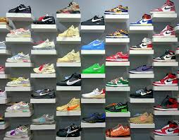
Ghafar’s Shoe Store Inventory System
By: Ghafar Arogundade
COSC 112
12/9/2024

Slide 2
An inventory management system that allows the user to update inventory, track product stock levels, and receive sales reports.
Project Description
Mostly utilizes arrays, loops, and if statements.

Slide 3
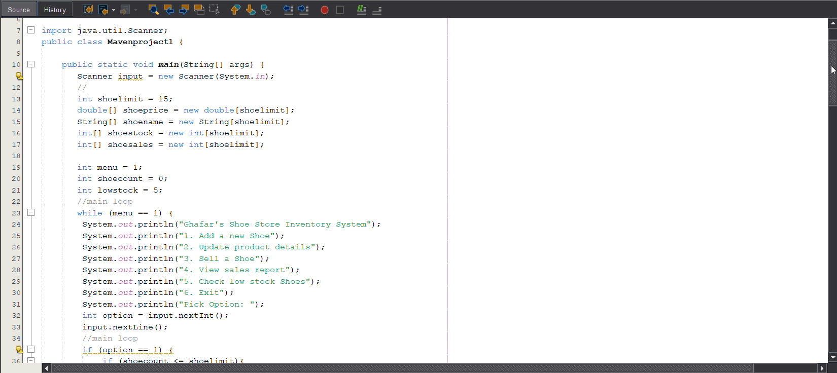
Full Code:

Slide 4
Key Parts of The Code

Slide 5
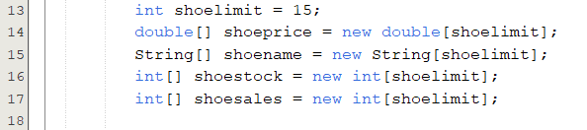
These are the main arrays of the program. I used these arrays to store al the major value of each shoe, the price of the shoe, the name of the shoe, how much of the shoe is in stock, and how many times the shoe has been sold. The integer variable shoelimit is set to 15 making the array length 15 for all the arrays. Basically, I can only have 15 different shoes in inventory at one time.

Slide 6
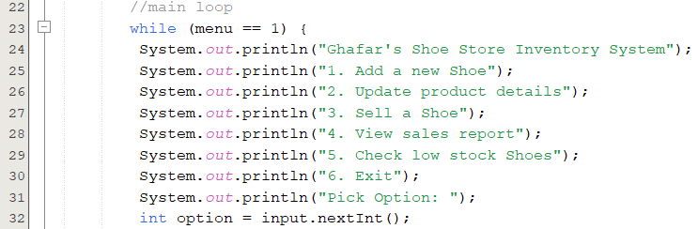
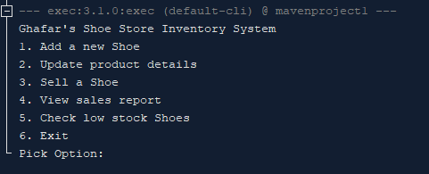
This is the code for the menu that the user has to choose from.
Output:

Slide 7
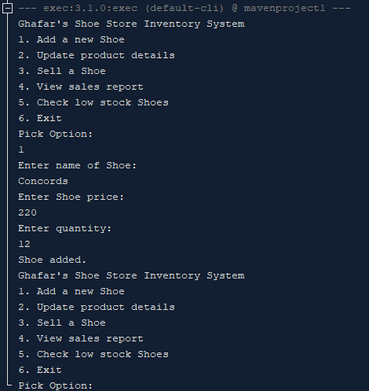
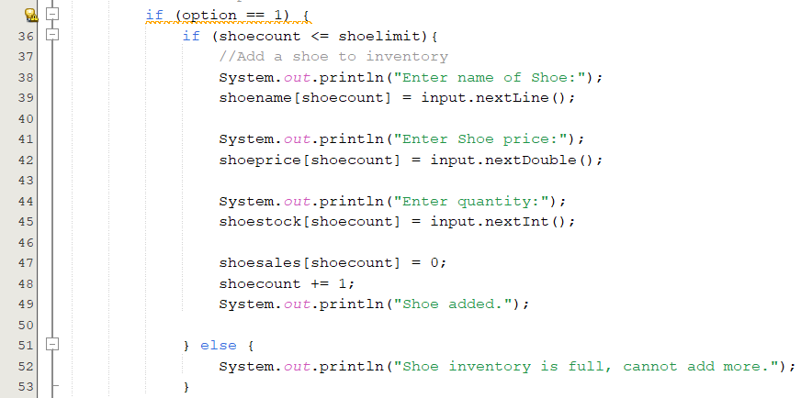
If the user selects 1 and the different number of shoes does not exceed to shoe limit (shoelimit = 15) this is the code that will execute.
This code allows the user to add a pair of shoes to inventory, it asks for the name, the price, and how many will be added in stock.
shoecount is initially set to 0 and has an incrementation of 1 every time this code loops around. This way the values for each specific shoe will be in the same index for each array.
The value stored in the array shoesales is also set to 0 since the shoe is just being added to inventory and no sales have been made yet
Output:

Slide 8
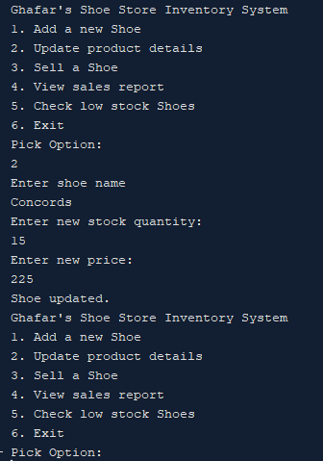
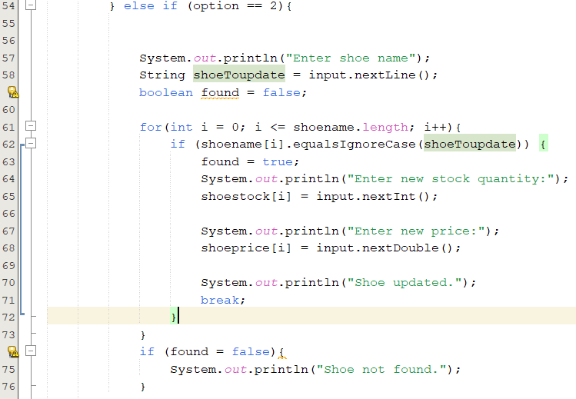
If the user selects option 2 this is the code that will execute. This code allows the user to update the information on a shoe in inventory.
It utilizes a for loop to find the value in the array “shoename” that matches the String value inputted by the user.
This allows the user to change the stock quantity and change the price
Output:

Slide 9
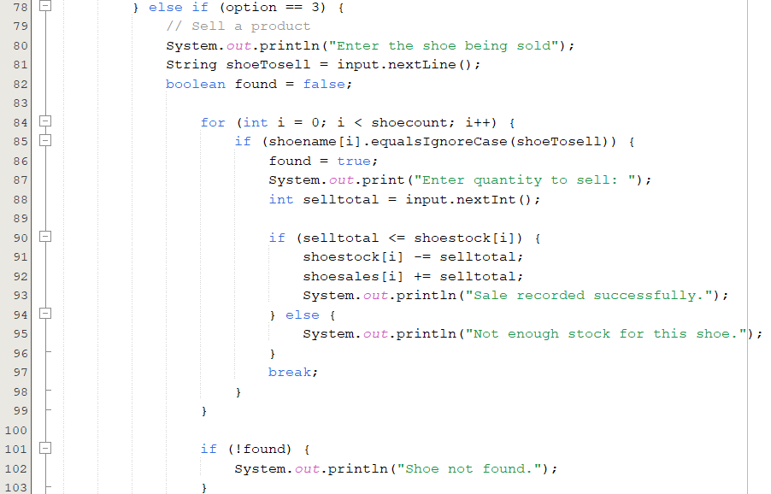
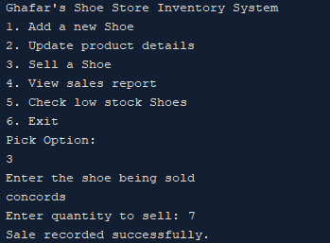
If the user picks option 3 this is the code that will execute. This code allows the user to sell shoes that are in inventory.
It utilizes a for loop that finds a value in the array “shoename” that matches the String value inputted by the user. It will then prompt the user to indicate the quantity of how may shoes are being sold. It then subtracts the number of shoes in stock in the array ”shoestock’ by how many are sold, and adds the money received to the array “shoesales.”
Output:

Slide 10
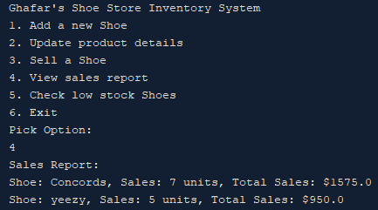
If the User select 4 this is the code that executes. It allows the user to view the sales reports of all the shoes that are in inventory. It shows the user the number of sales, and the amount of money made.
It utilizes the for loop that goes through the variable “shoecount”
Output:

Slide 11
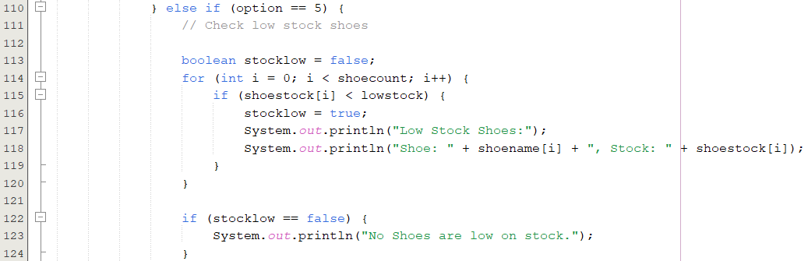
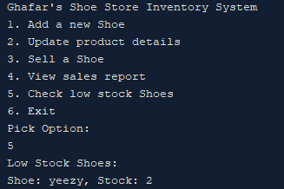
If the user selects option 6 this is the code that will execute. It allows the user to check if there are any shoes that are low on stock. The variable “lowstock” is set to 5 any shoe that has less than 5 pairs in stock will be considered low in stock.
It utilizes a for loop to go through the array “shoestock” to see if any index has a value less than 5. If an index has a value less than 5 it will print the name of the shoe and the number in stock
If no index in the array “shoestock” has a value less than 5 it will print “No shoes are low on stock.”
Output:

Slide 12
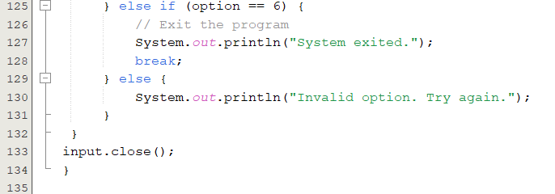
This is the end of the code
If the user chooses option 6 the loop is broken and no longer repeats
If the user doesn’t input any of the numbers 1-6 the user is prompted to try again.

Slide 13
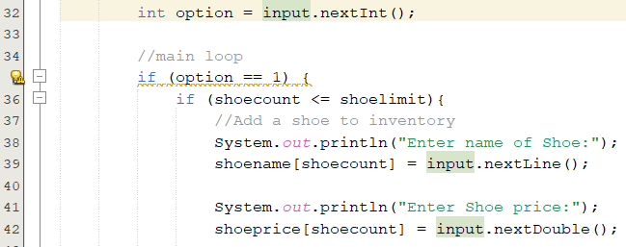
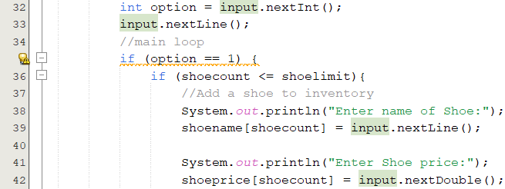
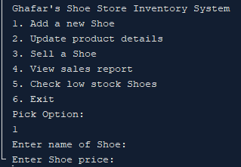
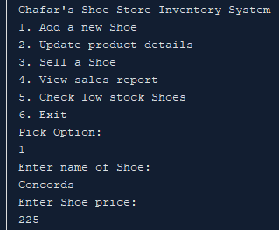
Key Challenges:
I kept getting this in my output where it would skip the line where the user would be able to enter the name of shoe and go to the line where the user enters the price.
Before:
After:
After some research I had to add the line
“input.nextLine();.”

Slide 14
I think I could have probably made things easier by utilizing a switch statement instead of if else statements. I also could’ve used methods to make my code shorter. I could also go a step further and specify on shoe size. In conclusion, I was able to make an inventory management system where the user could track stock levels, sales, add/update products, generate low stock reports, and produce sale reports.
Final Thoughts

